Slide 1
Bank Loan Default and Loss
Nikhil Kumar Sampath, Snehitha Anpur, Kiran Kour, Shivani Pitla
MIS64037-003: Advanced Data Mining And Predictive Analytics
Professor Dr. Rouzbeh Razavi

Slide 2
Project Goal
This project aims to improve loan default prediction by considering both the probability of default and potential loss. By optimizing risk to the financial investor, it can bridge the gap between traditional banking and asset management, leading to better outcomes for both the investor and borrower.

Slide 3
Overview of Data
The initial Dataset was overwhelming with anonymous ID numbers and poorly labeled columns.
Aimed to bridge traditional banking with asset management by optimizing the risk for financial investors while minimizing economic capital consumption
Extensive data-cleaning process undertaken to prepare data
Examined data structure, missing data, zero/near-zero variance variables, and high correlations
"Loss" column discovered to contain valuable default information

Slide 4
Data Structure
Dataset has 79999 rows and 762 columns
All variables in the dataset are numeric
Target variable - "loss" (Default or Non-Default Value)
Variables are anonymous and challenging to interpret

Slide 5
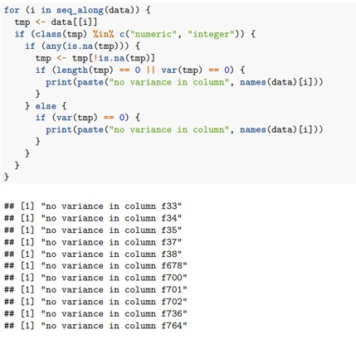
Data Cleaning and Feature Reduction
Feature reduction involved eliminating features with no variance, and high multi-collinearity. Later to this, we will be using Lasso to further reduce the feature size.

Slide 6
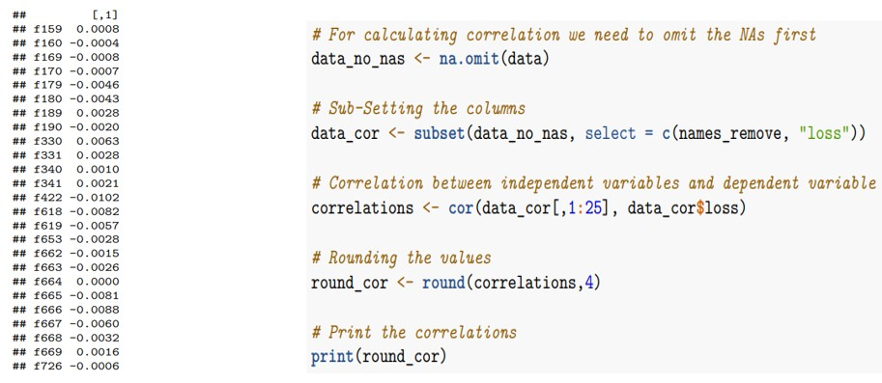
Reviewing the Missing Values
Missing value analysis revealed numerous NAs throughout the dataset, with some columns containing up to 17.8% NAs. Columns with more than 10% NAs were eliminated.
Correlation checked between attributes with missing values and "loss" before dropping columns.
No significant relationship was found between attributes with missing values and "loss" based on correlation analysis.

Slide 7
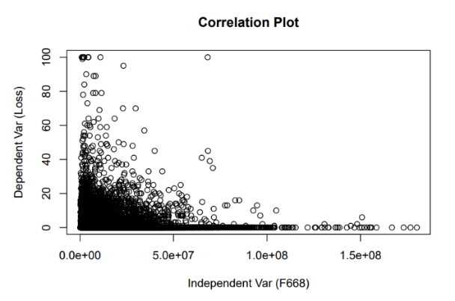
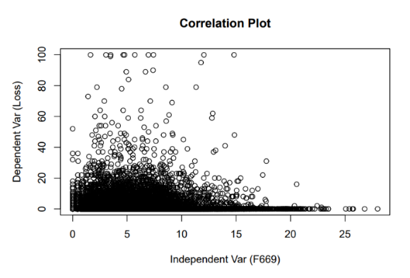
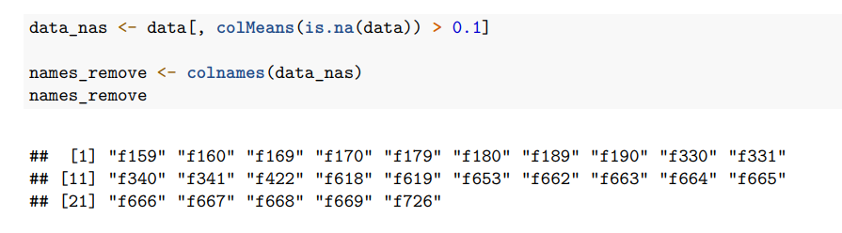
Scatter plots used to visualize the absence of correlation between missing value attributes and target variables.
We dropped columns with over 10% missing values and zero variance instead of removing all attributes with missing values. This reduced the number of columns from 762 to 726, allowing us to keep important attributes. However, some attributes still required treatment, and feature reduction is critical for efficient modeling.

Slide 8
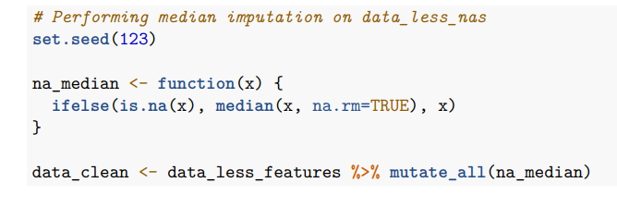
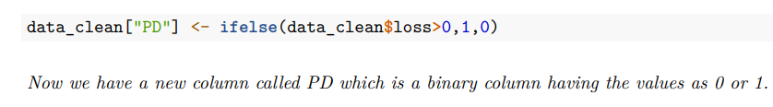
Imputing Missing Values
Considered missForest, MICE, and KNN imputation but found them computationally expensive for imputing missing values in the dataset.
We chose median imputation as it was computationally efficient and robust against outliers in the data.
Missing values were imputed, and no NAs were found. A binary column named PD was created as the target variable for the Probability of loan default model.

Slide 9
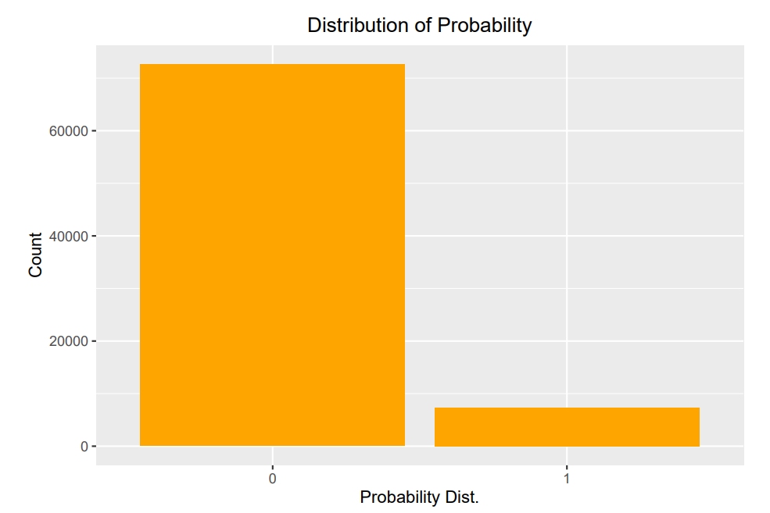
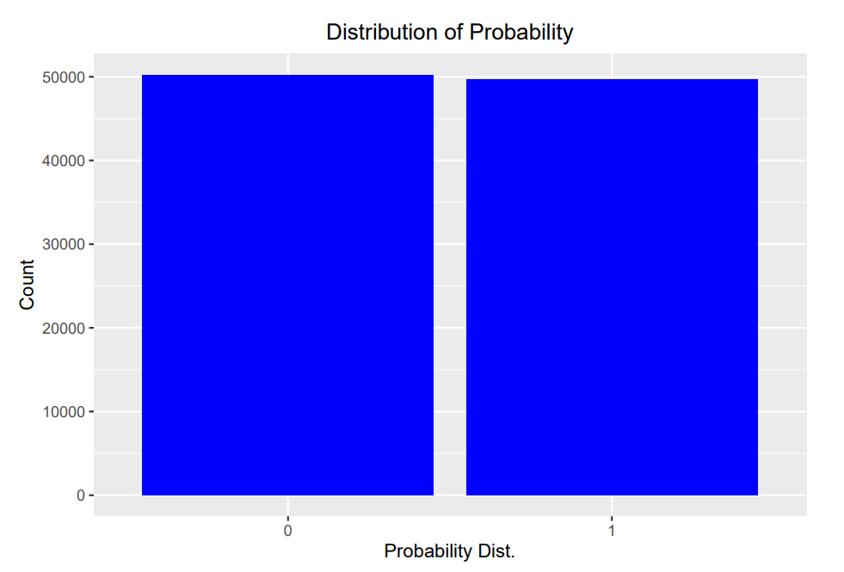
Balancing both classes with the help of Synthetic Data
Dataset was balanced with synthetic data to avoid bias towards majority class.
Before balancing, "not default" had 72,620 observations, and "default" had 7,379.
After balancing, "not default" decreased to 50,259, while "default" increased to 49,741, helping the model learn about the features of both classes and prevent bias.
The above figure shows the difference between the row count for “no default (0)” and “default (1)” before and after balancing the classes.

Slide 10
Feature Selection
Feature selection is selecting a relevant subset of features to improve machine learning models' performance and efficiency.
Techniques such as Boruta, step-wise regression, PCA, and PLS are used for feature selection.
Boruta is computationally expensive, step-wise regression suffers from overfitting, PCA assumes linearity, and PLS requires careful component selection.

Slide 11
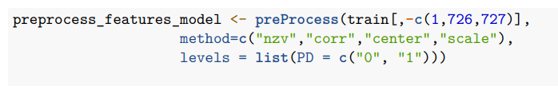

Feature Selection along with Normalization
Data is partitioned into train and validate sets to replicate the same features onto the test set for feature selection.
Feature reduction improves model efficiency and accuracy.
We removed low-variance and highly correlated features.
The number of features reduced from 726 to 253, excluding ID and loss.

Slide 12
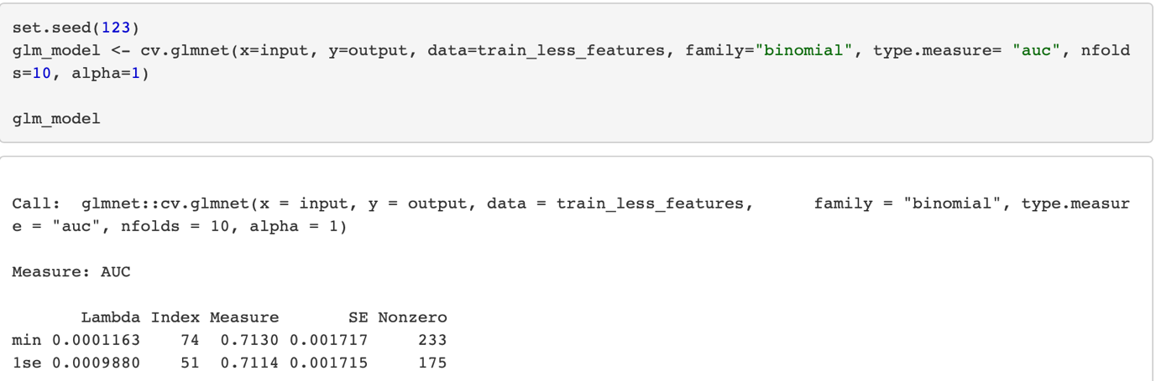
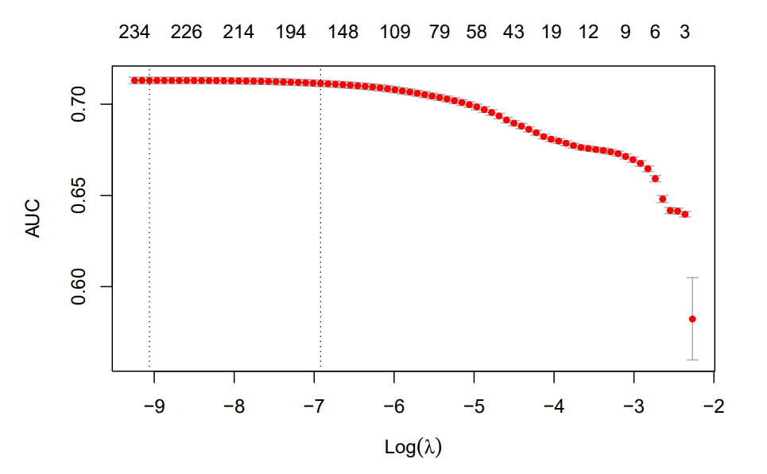
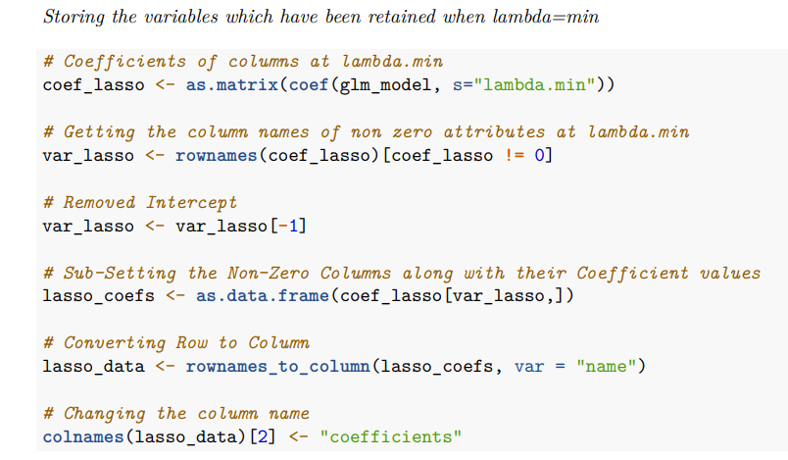
Lasso for Variable Selection
Lasso regression was used to select important variables for loan approval prediction based on default history, reducing the number of variables in the final model.
The figure shows the optimum lambda value for feature selection from 253 to 233 variables. The chosen lambda value is the minimum value, indicated by the first vertical dashed line.

Slide 13
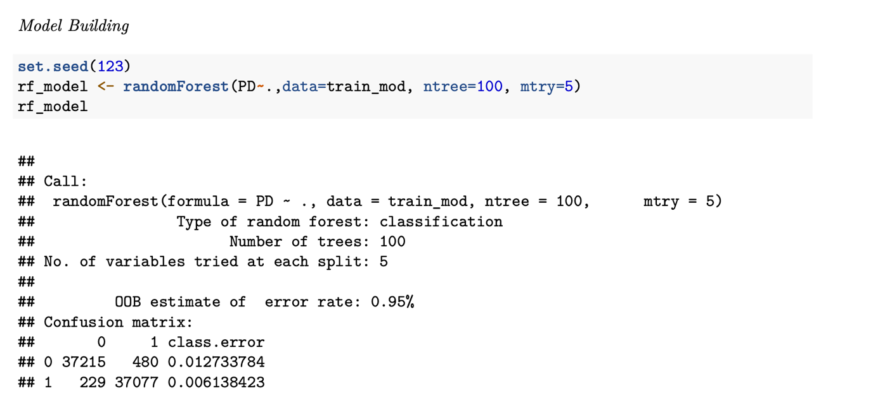
Model Building
Random Forest is a robust machine learning algorithm that can be used for classification tasks, and it has several advantages over other algorithms
The cut-off threshold set for rf_model was 0.6, meaning if the predicted probability class of 1 is greater than 0.6, it will be considered defaulted or else not defaulted.

Slide 14
Evaluation of Model’s Performance
AUC metric was used to evaluate model performance in the classification.
The "Random Forest" package was used to build the model
"ntree" and "mtry" were hyper-tuned to optimize the model's performance
Optimal values were determined as 100 for "ntree" and 5 for "mtry"
The resulting AUC was 0.997.

Slide 15
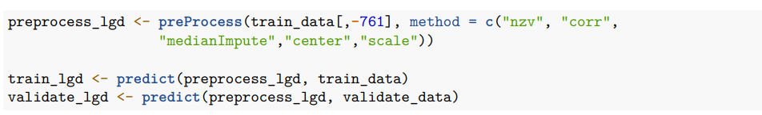
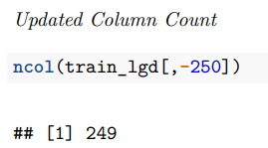
Loss Given Default (LGD) Exploratory Data Analysis
We are only sub-setting the observations where the loss value is greater than zero.
The columns with zero variance and colinear are being removed and missing values are being handled by median imputation.
Independent attributes are being scaled and centred.

Slide 16
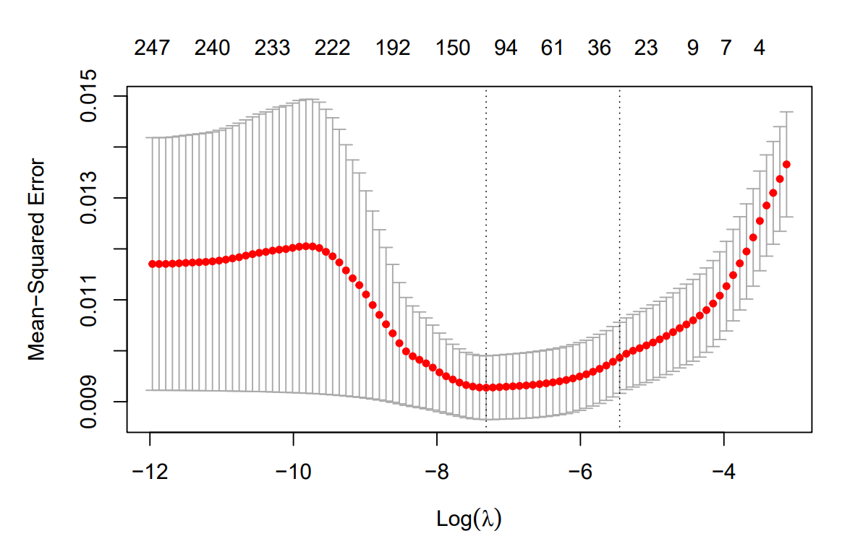
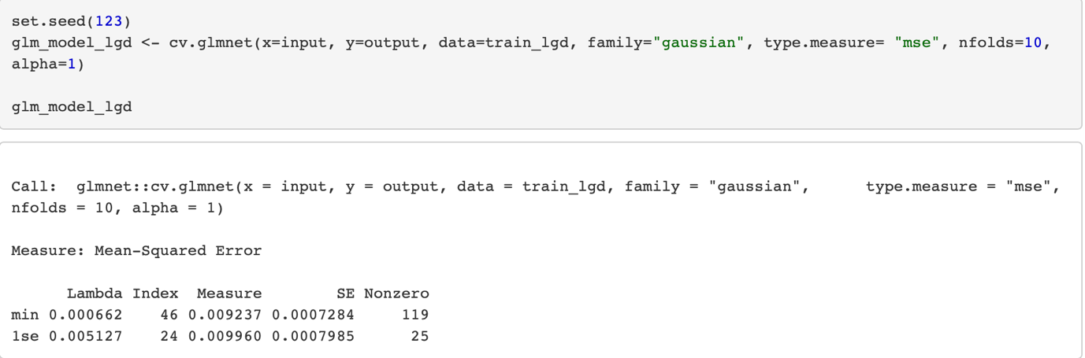
Lasso for variable selection

Slide 17
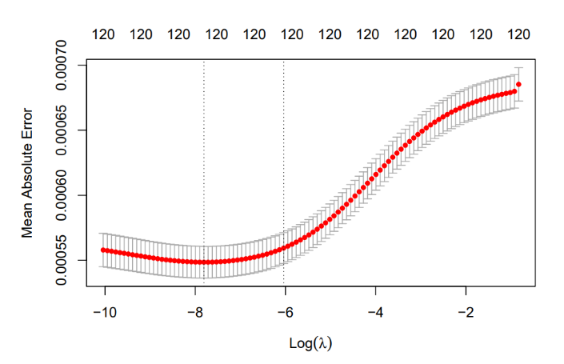
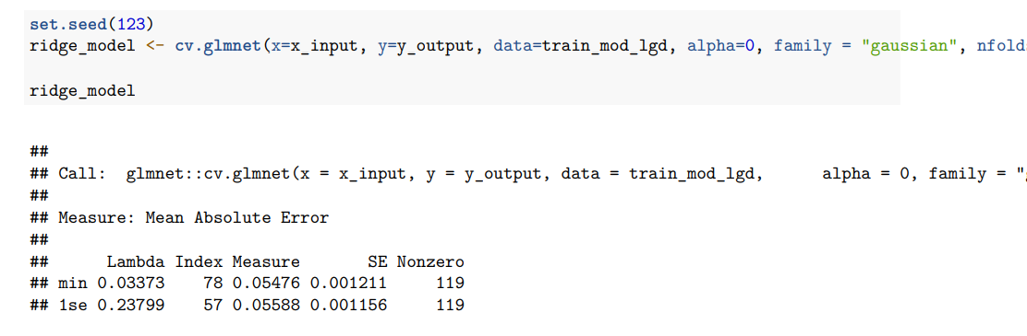
Model Building
Ridge regression is a linear method to model the relationship between a dependent variable and one or more independent variables. It is particularly useful when the number of independent variables is large or multicollinearity among the independent variables.

Slide 18
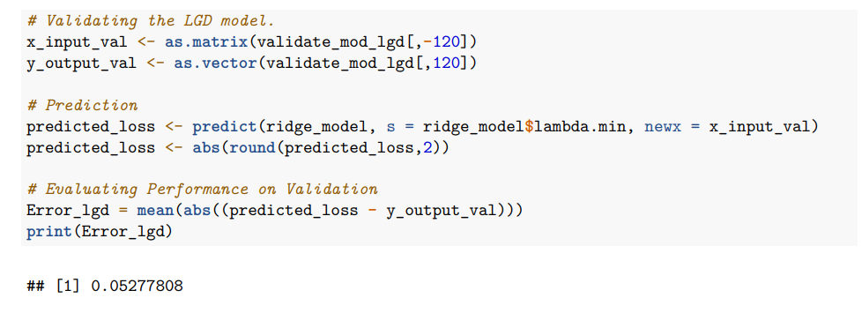
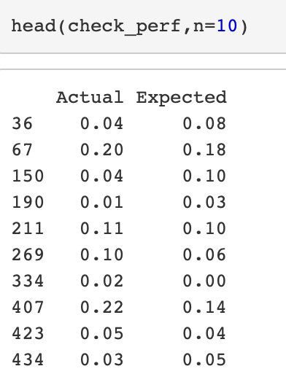
Evaluation of Model’s Performance
Prediction of the Ridge model on the validation set
The table shows that the actual and expected loss values are similar, indicating a good predictive power of the model towards the target attribute (loss).

Slide 19
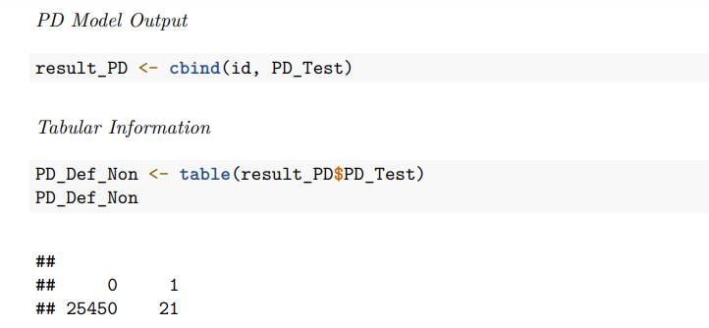
Model evaluation on Test set
Result of the PD model
We pre-processed the test data to make it similar to the train data, Before starting with the prediction of the PD and LGD model on the test set.
Once the data has been altered. we predicted the models on the test set.

Slide 20
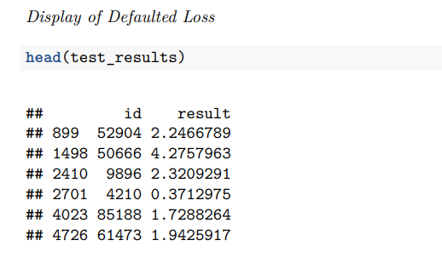
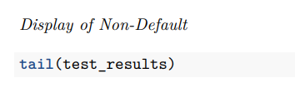
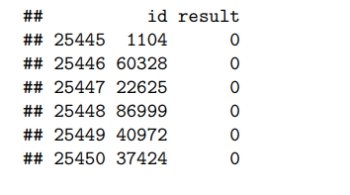
Now we are predicting the LGD model on the test set by sub-setting the 21 default observations which we got from the PD model.
The below image gives us an output of default and non-default observations which is the glance look of the final document.

Slide 21
Conclusion
The Probability Default and Loss Default Models are useful tools for financial institutions to assess customers' financial stability and default risk. These models have stable and reliable performance on unseen data, and they assist in making informed decisions regarding lending, risk assessment, and portfolio management. The use of feature reduction and missing value treatment are crucial in building robust models. Overall, the Probability Default and Loss Default Models provide a powerful approach for financial institutions to manage risk and make sound financial decisions.

